Slide 1
Task 4.1: Pub/Sub MQTT System and Anomaly Detection
Ragini Gupta
University of Illinois-Urbana Champaign
(PI: Klara Nahrstedt)

Slide 2
Task Goal
Design an end-to-end dataflow IoT platform using MQTT driven distributed streaming protocol for remote data monitoring, visualization and anomaly detection
Real-time sensor data streaming from MSA towers and application of unsupervised machine learning algorithms for anomaly detection to uncover hidden patterns and correlations, thus providing situational awareness.

Slide 3
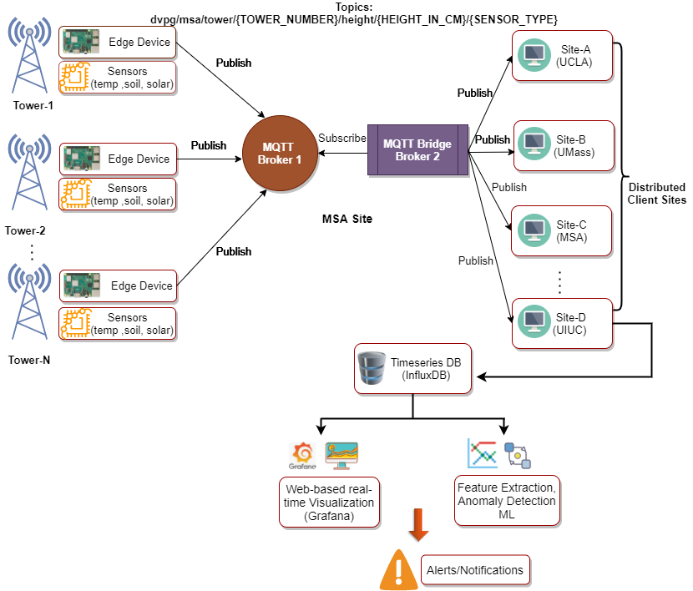
MQTT client application is employed to collect real-time IoT sensor data from MSA towers
Timeseries database (InfluxDB) is employed for sensor data ingestion & storage
Unsupervised machine learning algorithms and statistical methods are used to detect anomalous data points
Web-based real-time visualization platform is employed for data monitoring

Slide 4
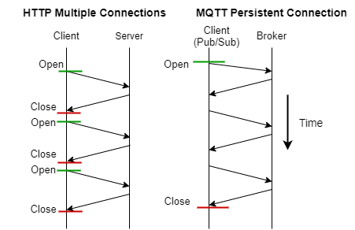
Message Queuing Telemetry Transport (MQTT)
Designed for lightweight M2M communications
Application layer protocol, relies on underlying TCP
Can support upto 200k concurrent connections on a single broker
HTTP | MQTT
Request-Response Paradigm | Publish-Subscribe Paradigm
Larger, few KBS | Small message size, header of 2 bytes
All messages get same service level | Three QoS settings
Data distribution: 1-to-1 | Data distribution: 1-to-1, 1-to-n, n-to-n
 | Low bandwidth usage, lower latency, higher network throughput, Utilization

Slide 5
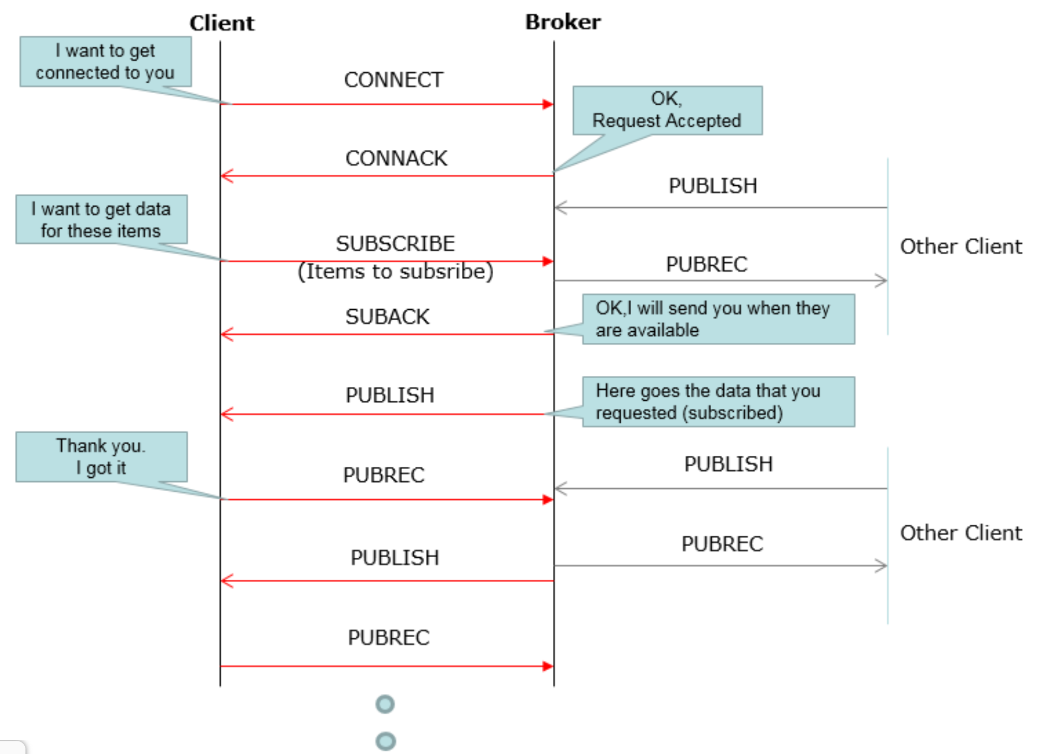
MQTT Protocol Sequence
Can use Wireshark Network Analysis tool for packet-level visualization
Source: http://www.sharetechnote.com/html/IoT/App_Protocol_MQTT.html
https://www.wireshark.org/docs/wsug_html_chunked/ChUseMainWindowSection.html

Slide 6
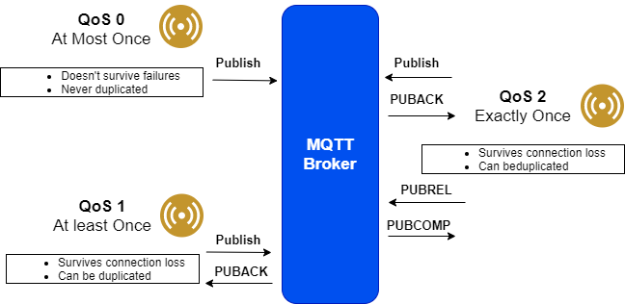
Design Principle:
Utility Functions: CONNECT, SUBSCRIBE, UNSUBSCRIBE, PUBLISH, DISCONNECT
Topics: Form of addressing for clients to share information, hierarchal structure
“parent route/child route/..”
A topic is defined by a (Name, QoS) tuple where,
name: identifies topic within the domain
QoS: level of guarantee for delivery (supports: 0,1,2)
Default QoS level set to 0, high frequency data
Maximum message size: 250 MB, Maximum Topic size: 65KB
For more information on MQTT packet structure and related specs, please refer:
http://docs.oasis-open.org/mqtt/mqtt/v3.1.1/os/mqtt-v3.1.1-os.html

Slide 7
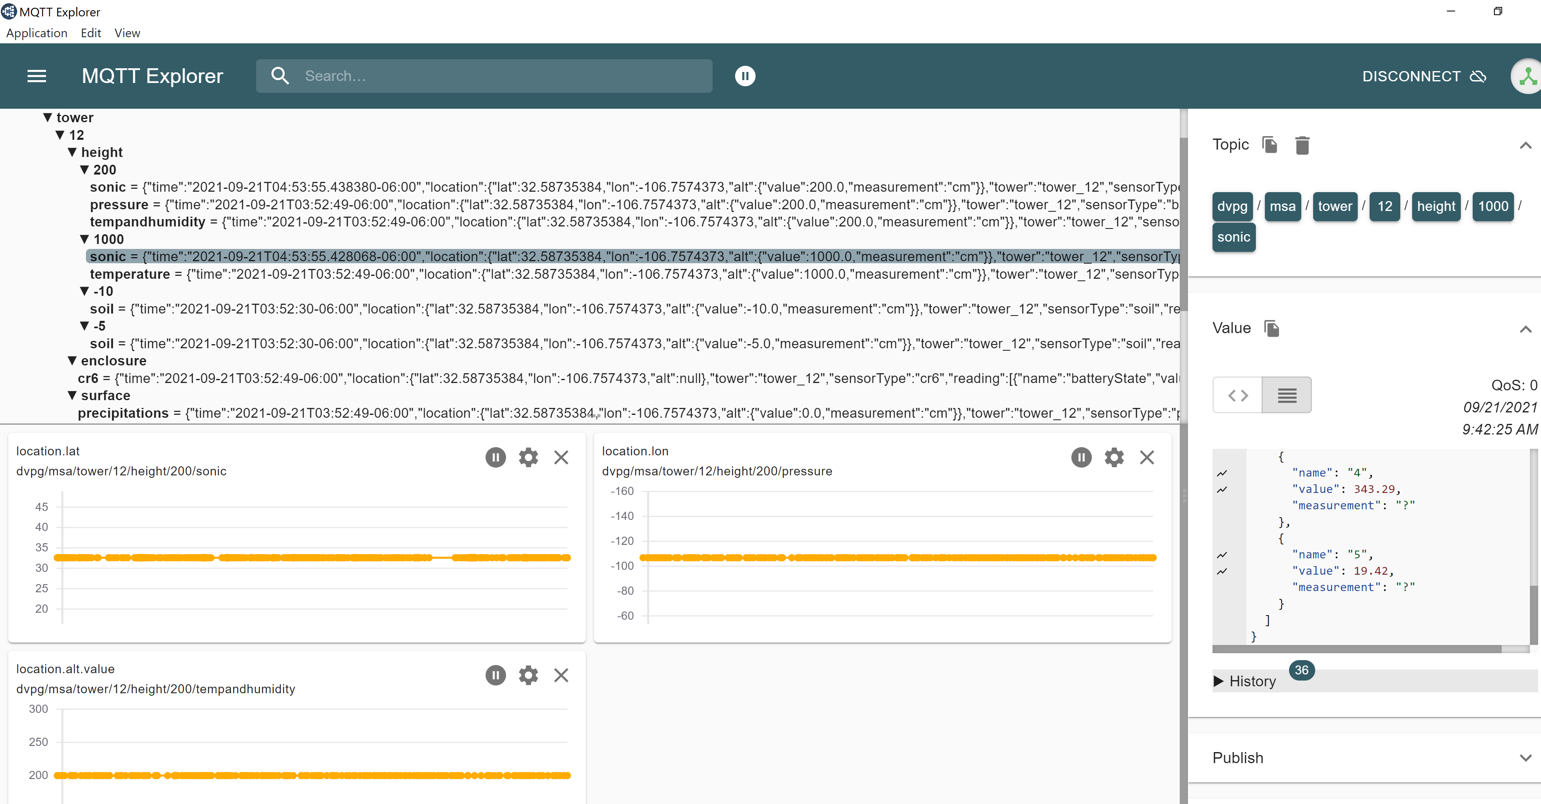
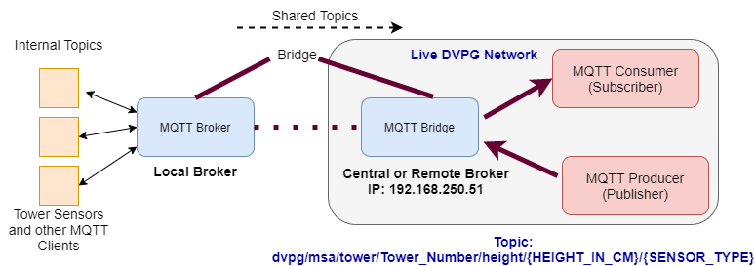
Technical Approach
Connect to the live DVPG network via ethernet connection to the MSA router
MQTT- Explorer Client Application (Quick diagnostic test)
Paho MQTT Library (Python, Java) (For logging and collecting data)

Slide 8
Dataset Description:
Text files
String dictionary of dictionaries
Sensor Frequency 1Hz, 20 Hz (Sonic)
~ 20 GB/day

Slide 9
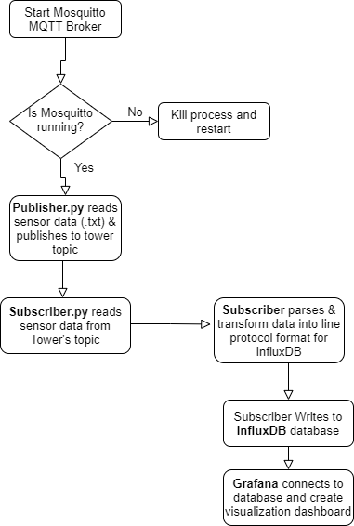
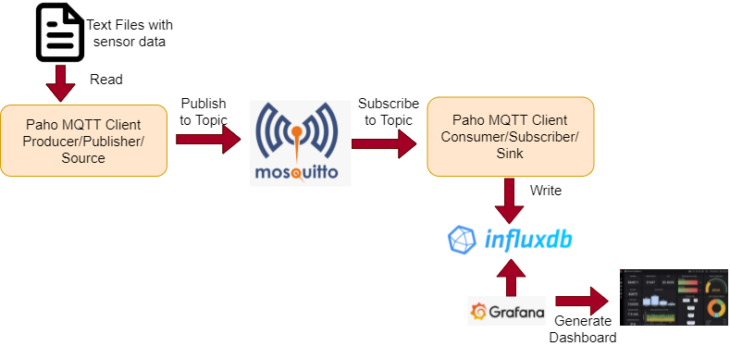
Technical Approach
Workflow

Slide 10
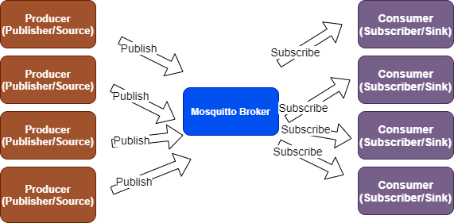
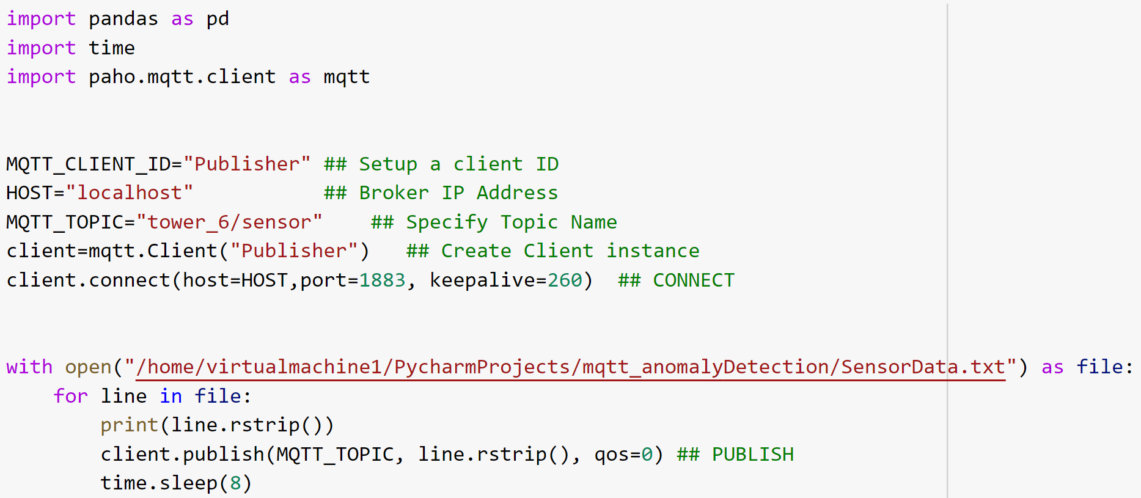
Technical Approach
MQTT Pub-Sub Paradigm
Publisher
Utility Functions:
CONNECT → Three parameters, Broker IP (Host), Port, KeepAlive (in seconds)
PUBLISH → Three Parameters,
Topic Name, Payload, QoS (by
default-0)

Slide 11
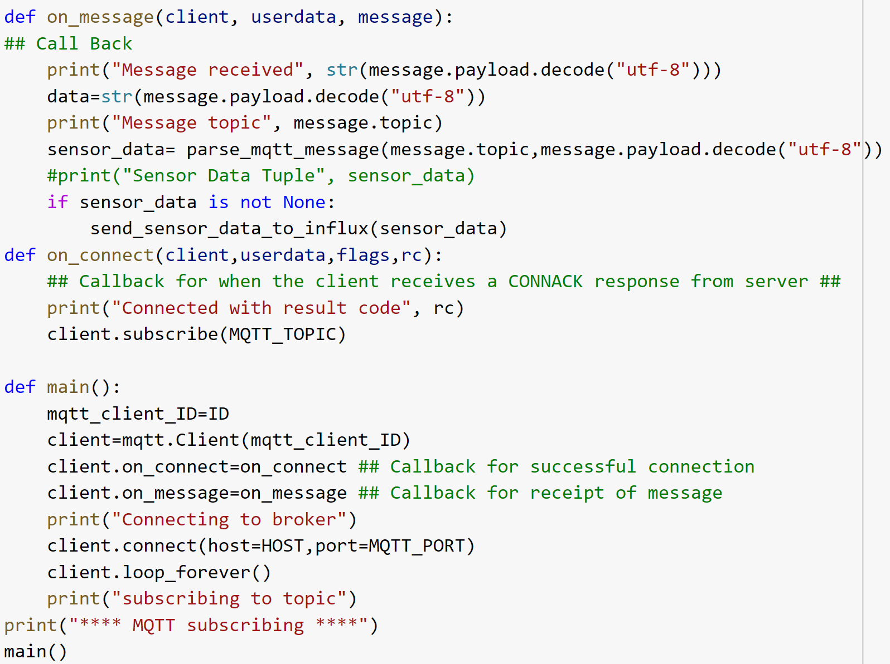
Subscriber
Utility Functions:
On_Connect Callback: When broker responded to subscription request (CONNACK)
On_Message Callback: Called for each message received , msg is MQTTMessage class with members- topic, payload
Subscribe: Inside On_Connect(), subscription is renewed for each reconnection

Slide 12
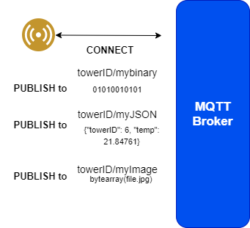
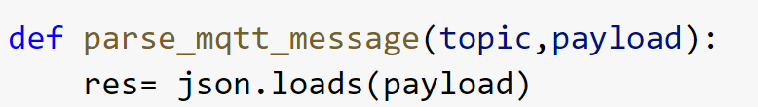
MQTT Message Payload and Decoding
Actual message payload ➔ Binary buffer
To decode, need to know format in which Payload is sent:
Text data: Decode using the UTF-8 decoder
JSON formatted String: Decode as string+ deserialization of JSON string into dictionary
File (binary data): No decoding
Number: Typecast using int(msg.payload)

Slide 13
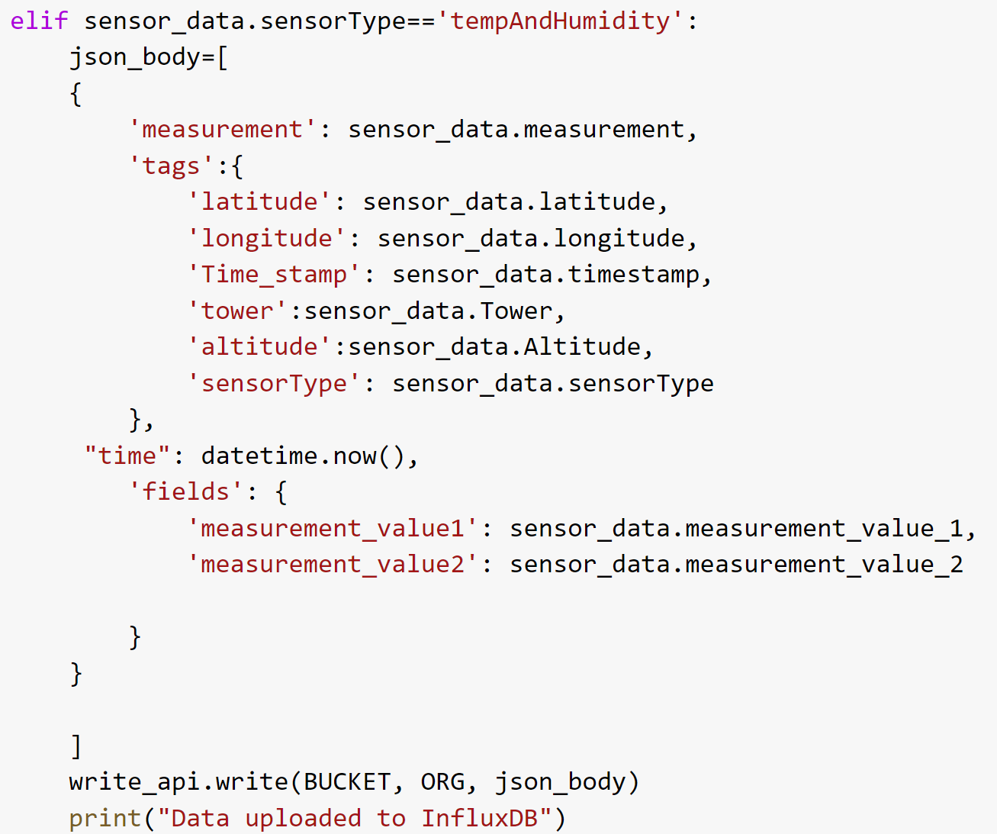
Database and Visualization
Using Influxdb-Client Python Module
InfluxDB Database supports line protocol (to write points into database)
Transform data into line protocol text-based data format on-the-fly
Three Key Parameters: Measurement (table name), Tags (Metadata), Fields (Values)
Parsing each Sensor data attribute and assigning attribute to tag/field/measurement within a JSON data structure
Write function to insert data into the bucket (database)

Slide 14
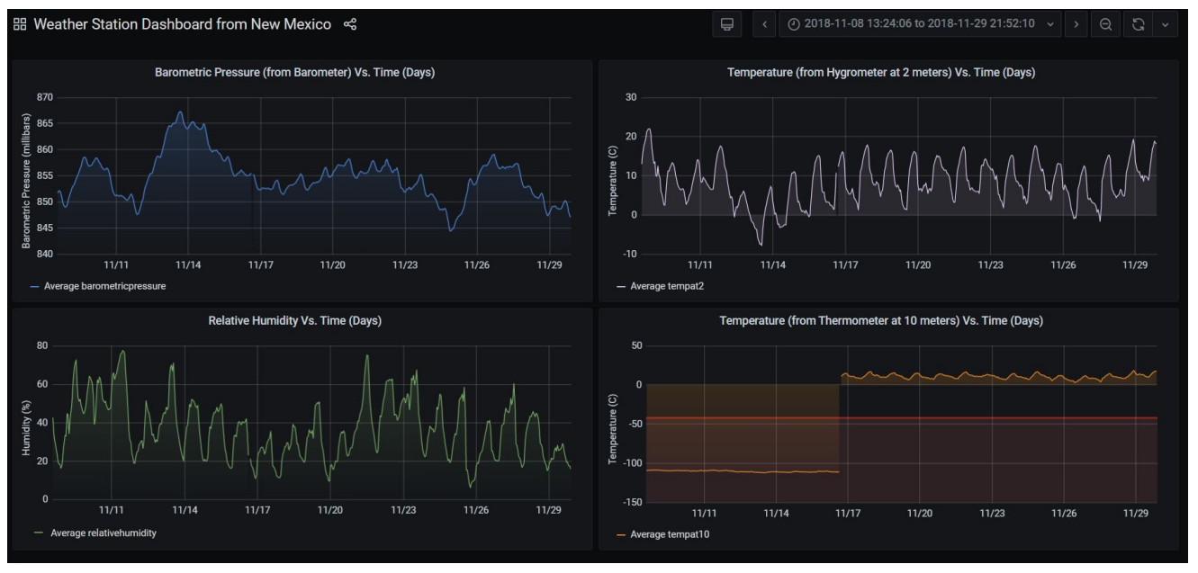
Technical Approach
Grafana Dashboard
Grafana is an off-the-shelf software for creating charts, graphs, reports for dashboarding in real-time
Connects to InfluxDB database, FluxQL query language
Can create alert rules by defining thresholds on sensor values
Built-in alert services: Email, Discord, Slack, PagerDuty
Ragini Gupta, et. al., "SVAD: End-to-end Sensory Data Analysis for IoBT-Driven Platforms", IEEE World Forum on Internet of Things (WF-IoT), 2021.

Slide 15
Detecting anomalies/irregularities
Anomalies: Irregularities in data that deviate from common statistical properties of a distribution including mean, median, modes, quartiles
Two significant features:
Occur very rarely in the data
Features differ from normal instances significantly
Applied techniques: Statistical method (Centroid based approach), Unsupervised ML (Isolation Forest, DBSCAN clustering)
Ragini Gupta, et. al., "SVAD: End-to-end Sensory Data Analysis for IoBT-Driven Platforms", IEEE World Forum on Internet of Things (WF-IoT), 2021.

Slide 16
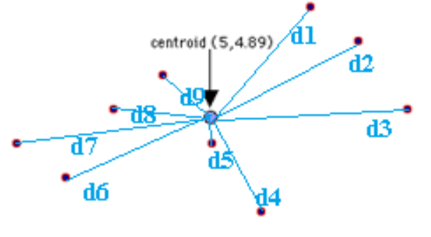
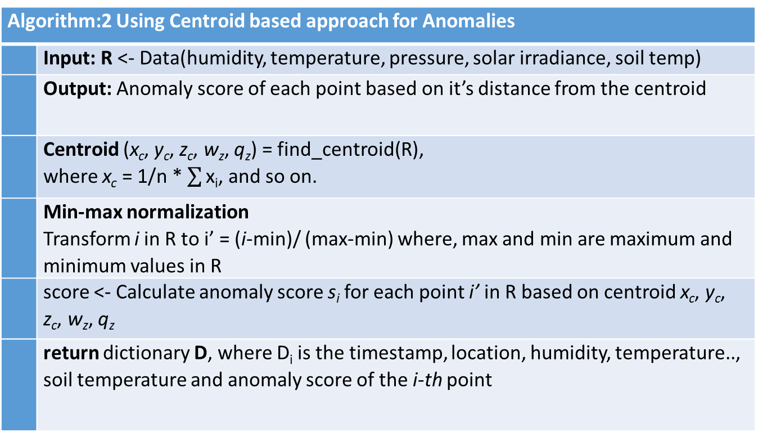
Approach
Algorithm:2 Using Centroid based approach for Anomalies
 | Input: R <- Data(humidity, temperature, pressure, solar irradiance, soil temp)
 | Output: Anomaly score of each point based on it’s distance from the centroid
 | Centroid (x_{c}, y_{c}, z_{c}, w_{z}, q_{z}) = find_centroid(R), where x_{c} = 1/n * $\sum{\text{x}\text{i}}$, and so on.
 | Min-max normalization Transform i in R to i’ = (i-min)/ (max-min) where, max and min are maximum and minimum values in R
 | score <- Calculate anomaly score s_{i} for each point i’ in R based on centroid x_{c}, y_{c}, z_{c}, w_{z}, q_{z}
 | return dictionary D, where D_{i} is the timestamp, location, humidity, temperature.., soil temperature and anomaly score of the i-th point

Slide 17
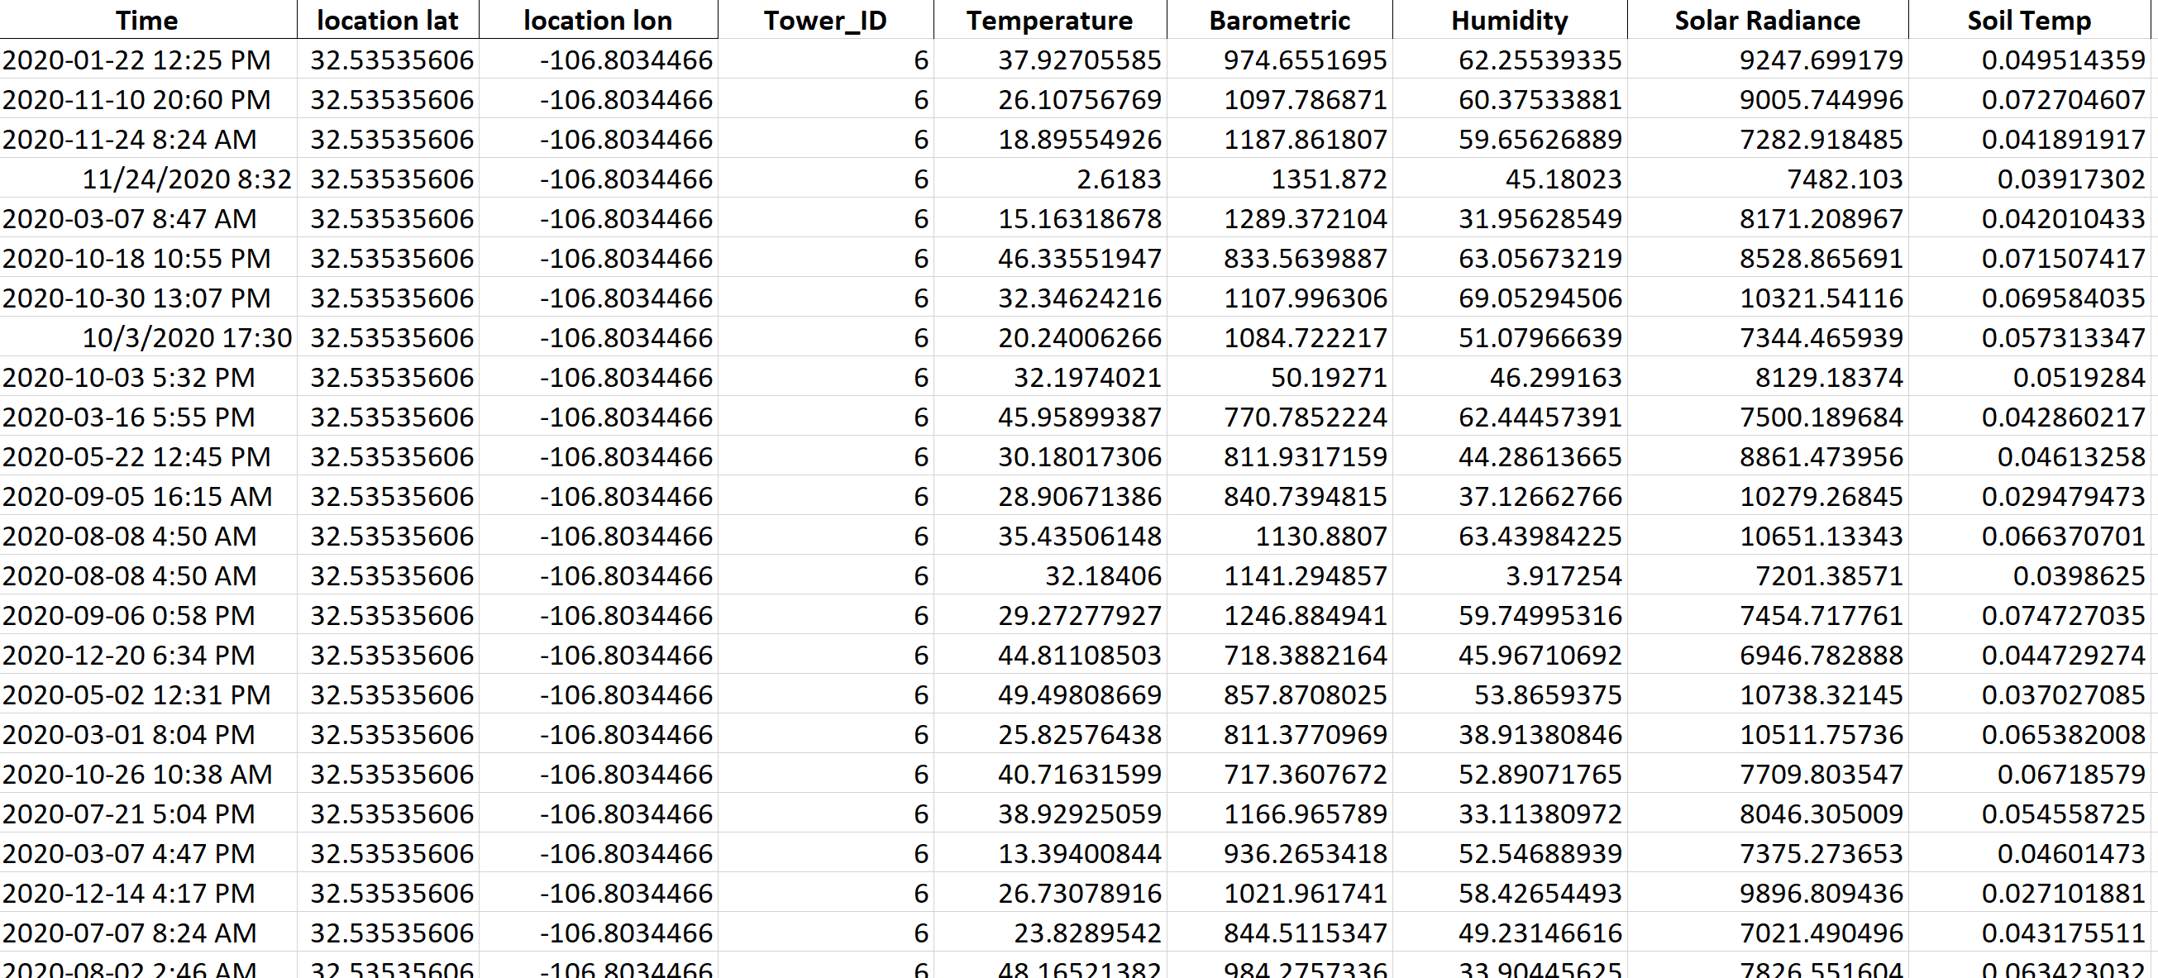
Methodology:
Dataset
Demonstrate time-stamps at which anomalies/outliers were found with their corresponding anomaly score (anomaly score: ranges from [0,1], 1 is most anomalous)
Dimensions considered : Temp, Humidity, Barometric Pressure, Humidity, Solar Irradiance, Soil Temperature
Anomaly Score: Distance of each point from the centroid
Centroid based result format: [timestamp , dim-1, dim-2,dim-3,..,dim-n anomaly_score]
Top 5 most anomalous points
Timestamp, Anomaly Score
[timestamp, location(latitude/longitude), tower_number, Pressure, Temp, Humidity, Solar irradiance, Soil Temperature, Anomaly Score]
timestamp Anomaly Score

Slide 18
Demo

Slide 19
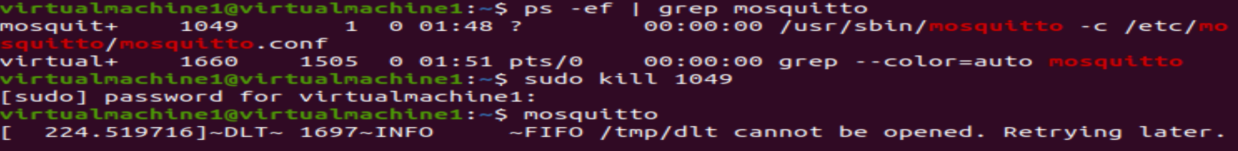
Steps: https://github.com/iobt/anomalyDetection_pubsub
Start your VM (password: virtualmachine1)
Open Pycharm Project >> mqtt_anomalyDetection
Start Moqsuitto broker on terminal window:
Start InfluxDB from terminal and open localhost:8086 on browser

Slide 20
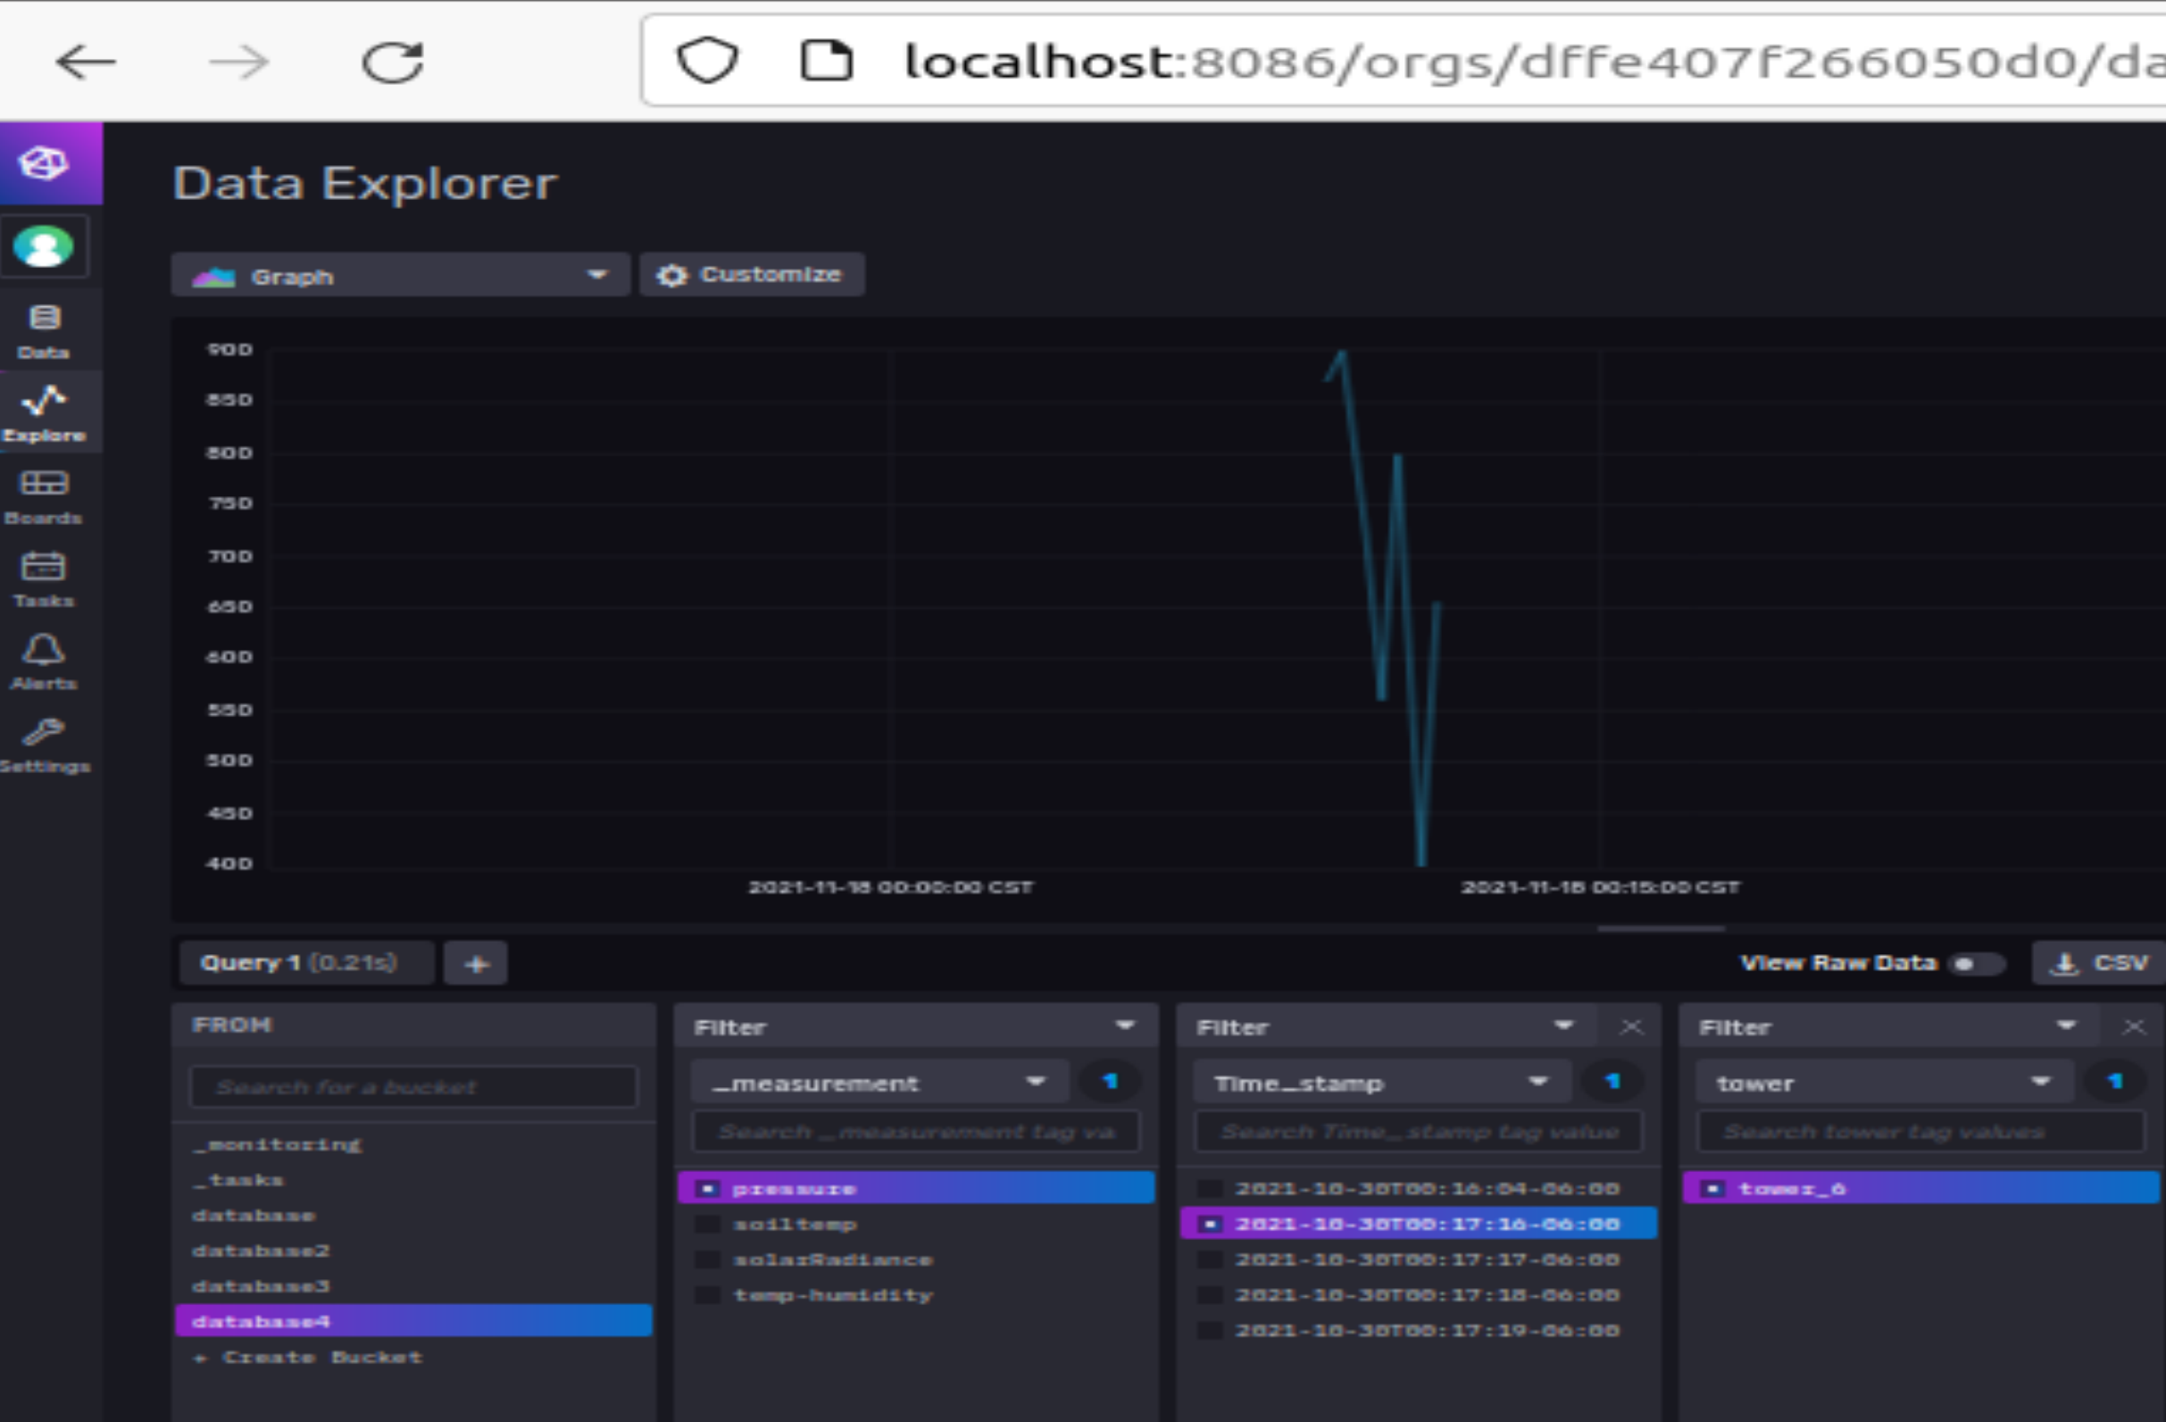
Create a new bucket on InfluxDB from http://localhost:8086
InfluxDB UI from browser

Slide 21
Specify database name in Subscriber.py in python project
Run Subsriber.py and Publisher.py synchronously (run as independent processes)
From cmd run:
>> python3 /home/virtualmachine1/PycharmProjects/mqtt_anomalyDetection/Publisher.py
Optional: Start Grafana instance using:
>> sudo /bin/systemctl start grafana server
Execute Anomaly Detection.py from python project

Slide 22
References:
https://github.com/iobt/anomalyDetection_pubsub
https://ieeexplore.ieee.org/document/9594944
On MQTT: http://docs.oasis-open.org/mqtt/mqtt/v3.1.1/os/mqtt-v3.1.1-os.html
On Influx QL Query (to query from Grafana query editor to InfluxDB): https://docs.influxdata.com/influxdb/v1.8/query_language/
Feel free to email for queries: raginig2@illinois.edu

Slide 23
Anomaly Detection
Three types of algorithms are exposed as anomaly detection services on the Weather-Sensor Data: Isolation Forest, DBSCAN clustering, Centroid based anomaly detection. Features (Temp, Humidity, Pressure)
Anomalies: Data points that are extremely low, high, few or deviate significantly from normal data distribution
Algorithm:1 Using Isolation Forest Algorithm for Anomalies
 | Input: R <- Data(humidity, temperature, pressure)
 | Output: Anomaly score of each point based on depth each point settles to and average path length
 | Let Q be the list of attributes in R
 | Randomly select an attribute q in Q
 | Randomly select a split point p from min and max values of attribute q in R
 | For each data point, i compute: X_{l} = i if i<p and X_{r}= i if i>p
 | score <- Calculate anomaly score s_i for each point i in X_{l} & X_{r} based on isolation forest approach
Algorithm:3 DBSCAN clustering
 | Input: R <- Data(humidity, temperature, pressure), eps – Minimum cluster distance, MinPts – Minimum points to form a cluster
 | Output: Cluster plot
 | Cluster index # C=1
 | For each unvisited point p in dataset R: Neighbors N = find the neighboring points of p # Find neighbors # mark p as visited
 | if N >= MinPts: N= N U N’
 | if p’ is not a member of any cluster:
 | Add p’ to cluster C

